Slide 1
CUSTOMER CHURN ANALYSIS USING POWER BI

Slide 2
OVERVIEW
Objective
To analyze customer churn in a telecom company and identify key factors influencing customers to leave the company.
Data Processing Cleaned and prepared telecom customer data, handled data types, and created required calculated measures in Power BI.
KPI Creation Created key KPIs such as Total Customers, Churn Rate, Average Monthly Charges, and Average Tenure for quick insights.
Churn Analysis by Factors Analyzed churn based on Internet Service, Contract Type, Tenure, and Payment Method.
Dashboard Pages Designed four interactive pages: Overview, Demographics, Account Analysis, and Churn Risk Analysis.
Visualizations Used Used bar charts, line charts, donut charts, line charts, treemap, and KPI cards for clear analysis.
Filters & Interactivity Implemented slicers like Churn, Internet Service, Contract, Tenure, and Payment Method for dynamic filtering.
Business Insights Identified high-risk customer segments and churn patterns for better decision-making.

Slide 3
OBJECTIVE
1] To analyze customer churn behavior in a telecom company using historical data.
2] To identify key factors such as Internet Service, Contract Type, Tenure, and Payment Method that influence customer churn.
3] To identify key factors such as Internet Service, Contract Type, Tenure, and Payment Method that influence customer churn.
4] To understand which customer segments are at higher risk of churn.
5] To support business decision-making using interactive Power BI dashboards.

Slide 4
DATA PROCESSING
1] Imported the telecom customer dataset into Power BI.
2] Checked and cleaned the data by removing inconsistencies and handling missing values.
3] Verified and corrected data types for numerical and categorical columns.
4] Used relevant customer attributes such as services, tenure, contracts, billing, and payment methods..
5] Created calculated columns and measures required for churn analysis.
6] Prepared the dataset for visualization and dashboard creation.

Slide 5
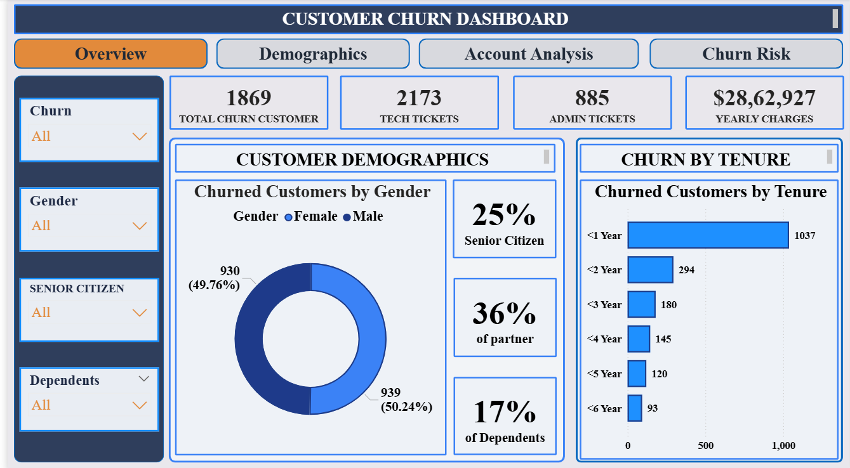
CUSTOMER CHURN DASHBOARD

Slide 6
Overview – Customer Churn Dashboard
This page provides a high-level overview of churned customers in the telecom company. It shows the total number of customers who have left, along with the support impact in terms of tech and admin tickets, and the revenue loss through yearly charges.
The gender-wise churn distribution highlights that churn is almost equally spread between male and female customers.
The tenure-based churn chart clearly indicates that most customers leave within the first year, and churn reduces as customer tenure increases.
Overall, this page helps quickly identify who is leaving the company, when they are leaving, and the immediate business impact of churn, making it easier to focus on early customer retention.

Slide 7
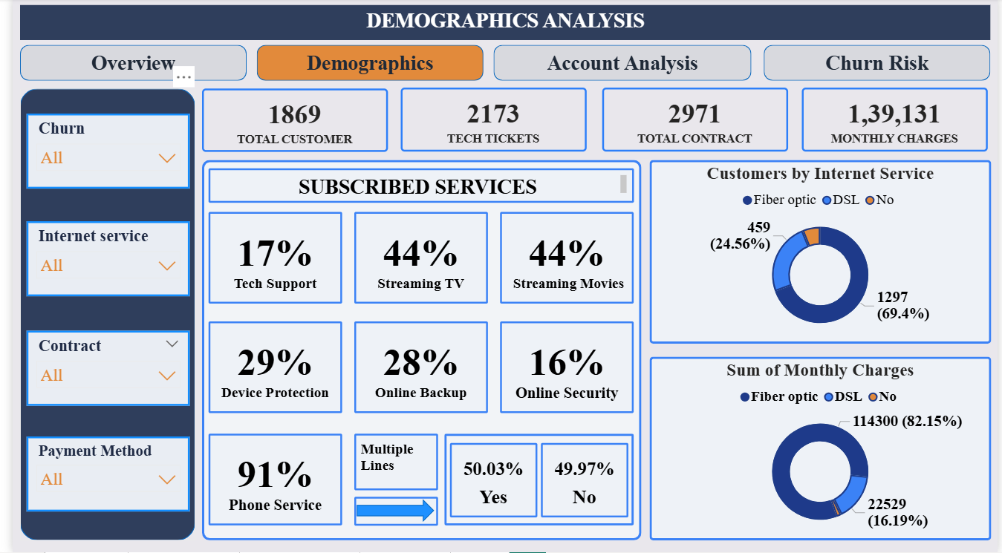
DEMOGRAPHICS ANALYSIS

Slide 8
Demographics Analysis – Customer Churn
This page focuses on the demographic and service usage patterns of churned customers.It highlights which services were most commonly used by customers who left, such as streaming services, phone service, and online add-ons.
The internet service distribution shows that a large portion of churned customers were using fiber optic services, which also contribute the highest share of monthly charges.
The multiple lines and phone service insights indicate that even high-usage customers are churning, increasing potential revenue loss.
Overall, this page helps identify which customer segments and service combinations are more prone to churn, enabling better targeting of retention strategies.

Slide 9
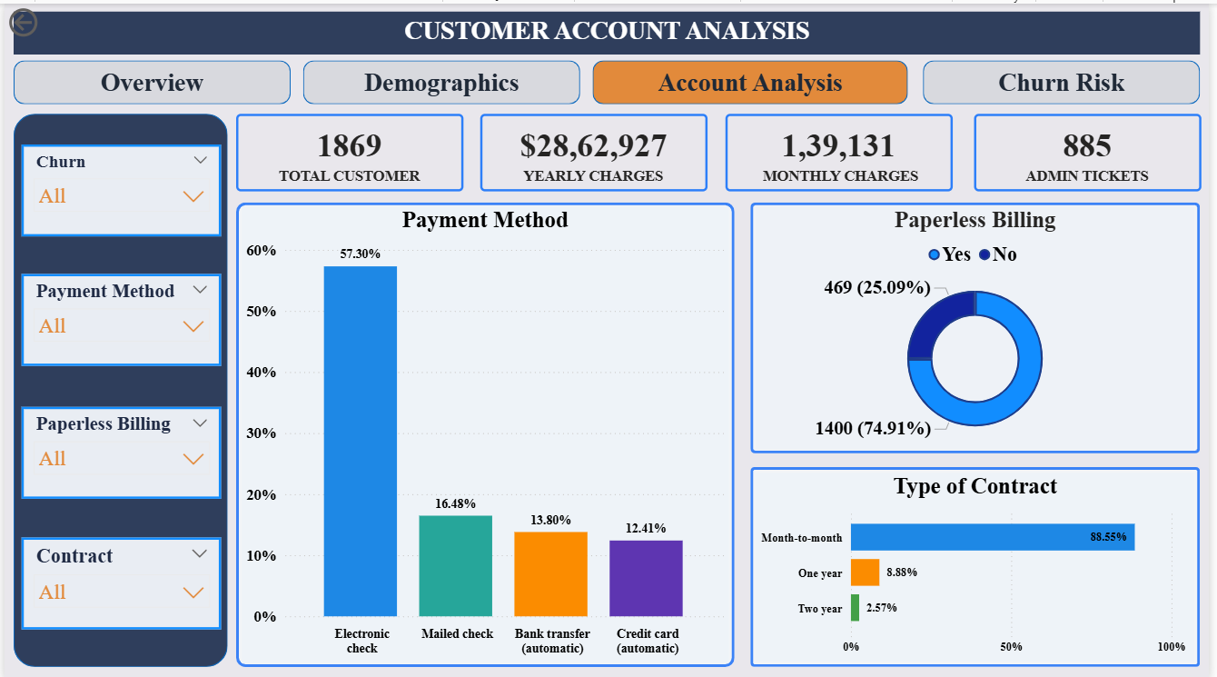
CUSTOMER ACCOUNT ANALYSIS

Slide 10
Account Analysis – Customer Churn
This page analyzes how churned customers managed their accounts and billing preferences.It highlights the preferred payment methods, paperless billing adoption, and contract types among customers who left the company.
The visuals show that month-to-month contracts and manual payment methods (such as electronic and mailed checks) have a higher churn association, while long-term contracts show lower churn.
The internet service usage chart further supports that high-value customers, especially those using fiber optic services, are contributing significantly to revenue loss when they churn.
Overall, this page helps understand which account behaviors and billing preferences increase churn risk, allowing the company to improve retention through better plans and billing strategies.

Slide 11
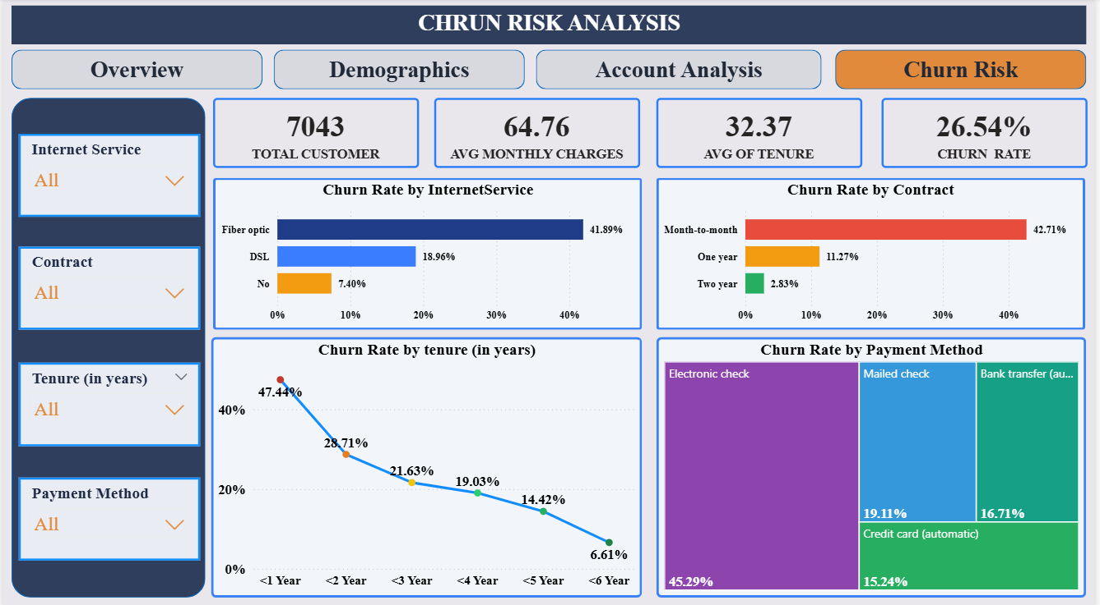
CHRUN RISK ANALYSIS

Slide 12
Churn Risk Analysis – Page Explanation
This page focuses on identifying churn risk across all customers using the complete dataset, not only churned customers.The KPIs at the top show the overall customer base, average monthly charges, average tenure, and overall churn rate, which together give a high-level view of churn exposure in the company.
The “Churn Rate by Internet Service” bar chart highlights that customers using fiber optic services have the highest churn rate, indicating higher risk in premium services.
The “Churn Rate by Internet Service” bar chart highlights that customers using fiber optic services have the highest churn rate, indicating higher risk in premium services.
The tenure line chart shows that churn is highest in the early years and decreases as customer tenure increases, proving that new customers are more vulnerable.Finally, the payment method treemap reveals higher churn among customers using manual payment methods, compared to automatic payment options.
Overall, this page helps the company predict where churn is most likely to occur in the future and highlights high-risk segments that need proactive retention strategies.

Slide 13
CONCLUSION
This analysis clearly shows that customer churn is strongly influenced by service type, contract duration, tenure, and payment method.
Customers using fiber optic services, on month-to-month contracts, with short tenure, and manual payment methods are at the highest risk of churn.
By improving service quality for high-risk segments, encouraging long-term contracts, and promoting automatic payment options, the company can significantly reduce churn and protect future revenue..

Slide 14
RECOMMENDATIONS
Improve service quality and technical support for fiber optic customers, as they show the highest churn risk.
Convert month-to-month customers into long-term contracts by offering discounts, loyalty benefits, or better plans.
Focus on new and short-tenure customers by providing proactive support during the first year to increase retention.
Encourage customers using manual payment methods to switch to automatic payments through incentives and awareness.

Slide 15


